Slide 1
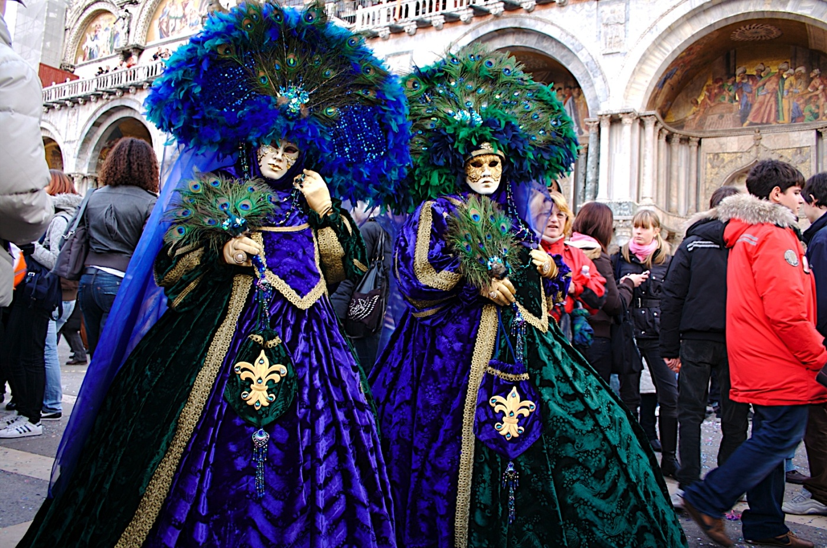
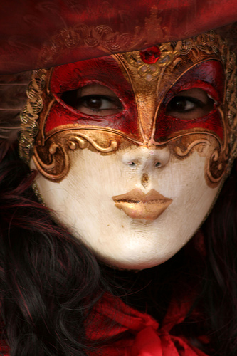
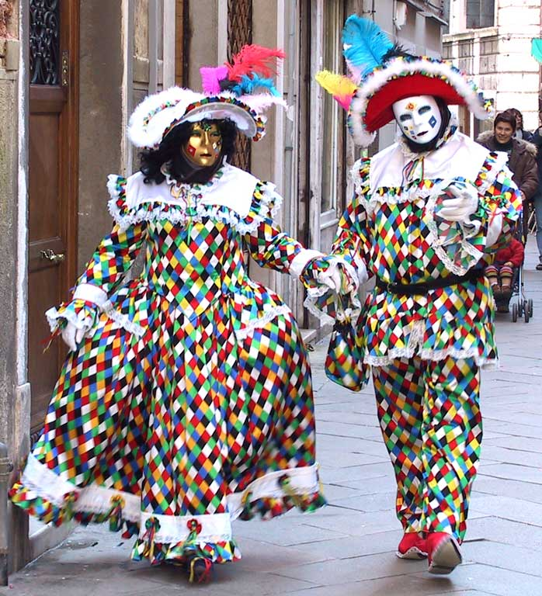
The carnival
of venice!!!

Slide 2
It’s wonderful, it’s always full of people!!

Slide 3
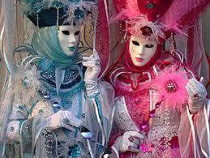
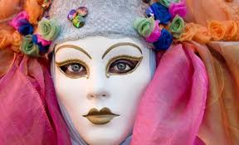
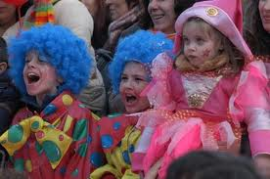
The Carnival of Venice is an annual festival held in Venice. The Carnival starts forty days before Easter and ends on Shrove Tuesday. Venetian masks can be made in leather or with the original glass technique. Nowadays, most of the masks are made with the application of chalk and gold leaf and are all hand-painted using natural feathers and gems to decorate.

