Slide 1
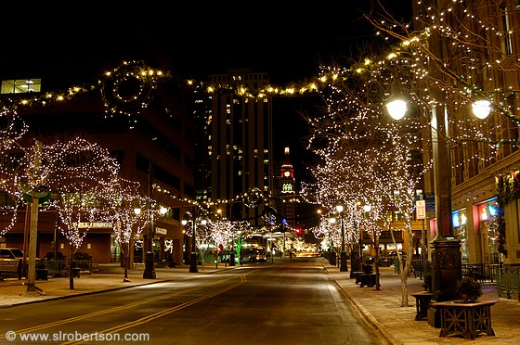
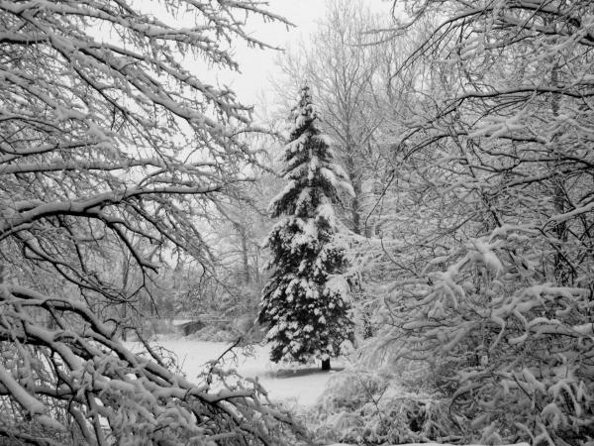
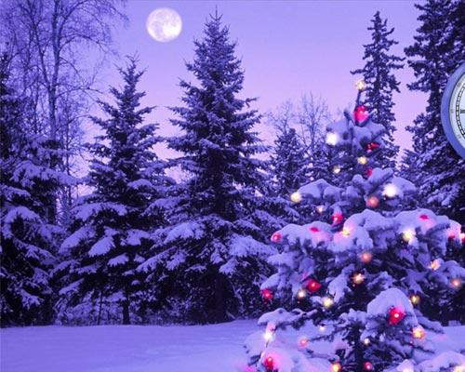
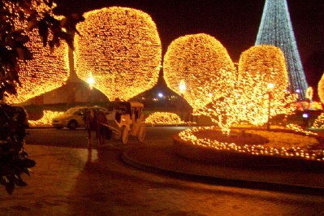
THE ITALIAN
CHRISTMAS

Slide 2
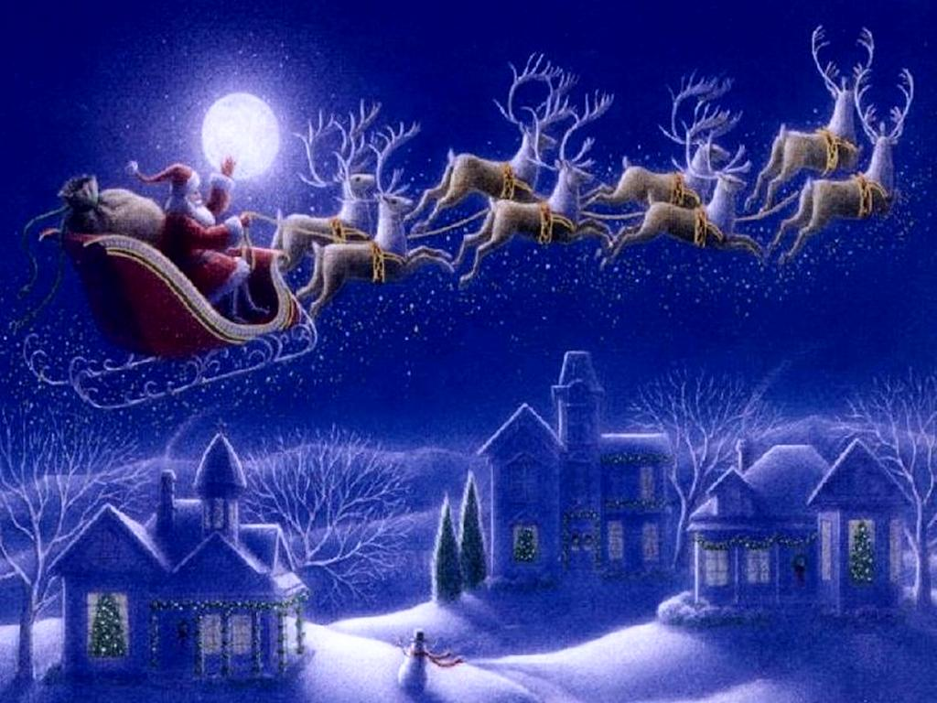
Christmas is a feast that celebrates Christ’s birth.

Slide 3
Officially, the Italian Christmas celebrations start on 8th December with the Immaculate Conception's Day and lasts until January 6th.

Slide 4
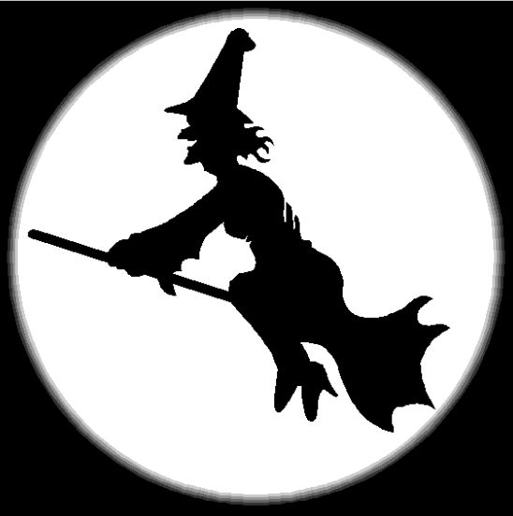
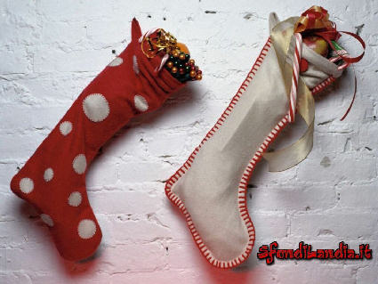
Actually, Italian children write letters to Santa Claus asking for presents, but traditionally in Italy the main day for gift giving is Epiphany; these presents are brought by La Befana, a kindly old witch who fill children's stockings in the night with sweets or with coal.

Slide 5
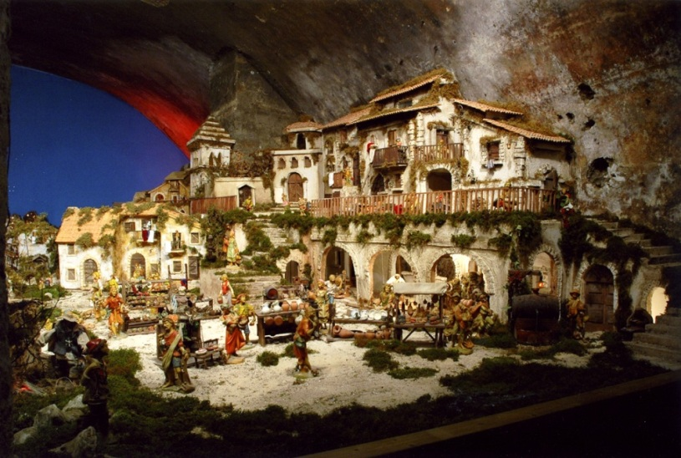
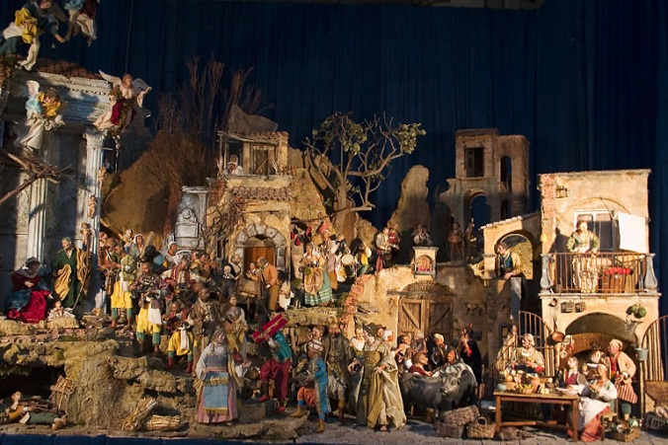
Decorations
The nativity scene is a representation of the birth of Jesus, derived from medieval traditions. In the nativity scene all the characters and places of tradition are reproduced, from the cave to the star, the Magi, the shepherds, the ox and the donkey, the lambs, and so on.

Slide 6
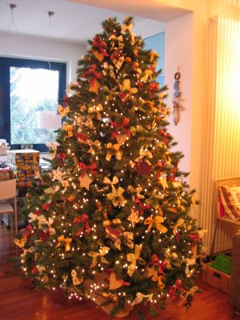
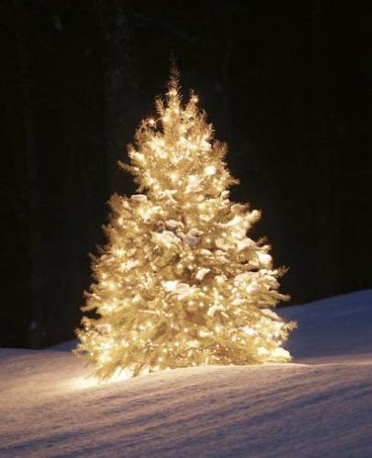
The Christmas tree is, like the tradition of the nativity scene, one of the most popular Christmas traditions. It is usually a fir tree decorated with small coloured objects, lights, garlands, sweets, small wrapped gifts and more.

Slide 7
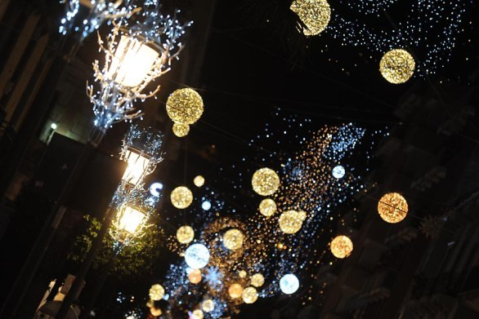
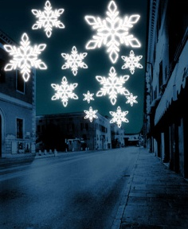
Lights and decorations around the towns are often seen starting around December 8, the Feast Day of the Immaculate Conception.

Slide 8
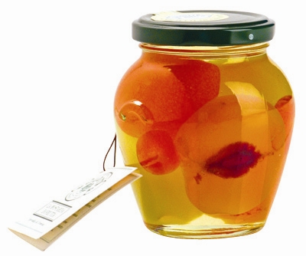
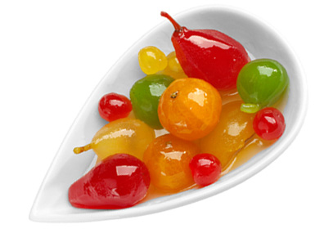
Traditional Christmas dishes
The mustard in Italy is a culinary product with fruit, sugar and mustard essence, usually very spicy.

Slide 9
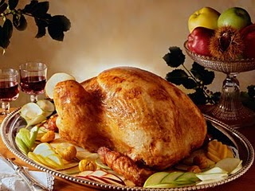
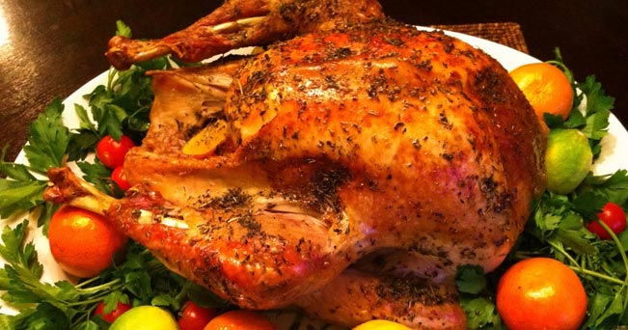
The capon is a rooster that has been castrated to achieve greater weight and softness of the flesh. It is one of the most classic dishes of the Christmas period.

Slide 10
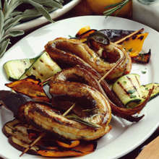
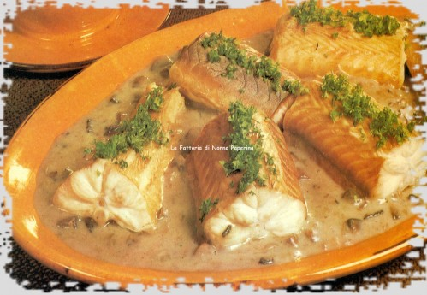
The eel is a must to Eve Dinner. It’s a serpentiform fish living in
freshwater, brackish and marine waters of the Atlantic and the Mediterranean.

Slide 11
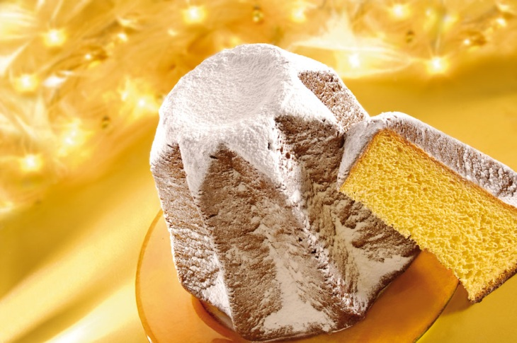
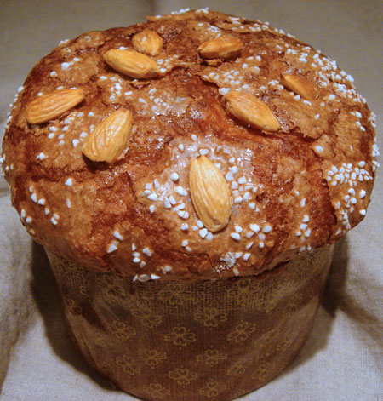
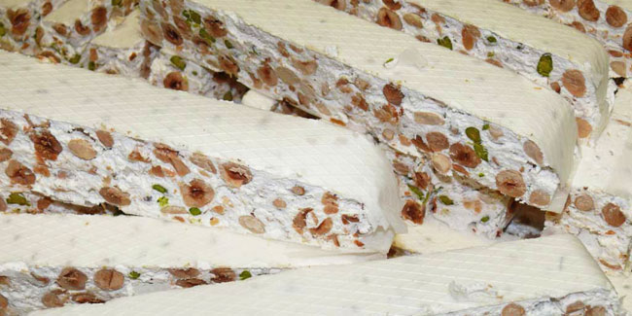
The most famous sweets usually eaten at Christmas are: panettone, pandoro and nougat

Slide 12
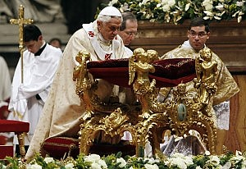
Midnight Mass
After the Christmas dinner, people usually go to the Midnight Mass
Saint Peter's Square in Vatican City hosts the popular midnight mass given by the Pope inside Saint Peter's Basilica
On Christmas day the Pope delivers his Christmas message from the window of his apartment overlooking the square

Slide 13
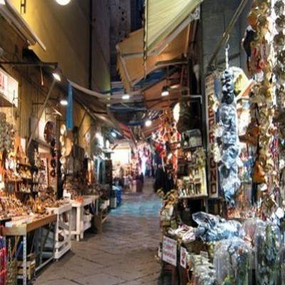
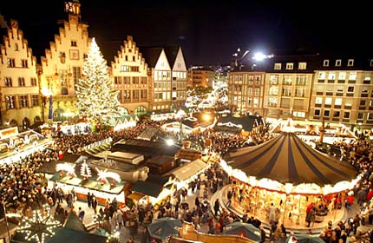
Christmas markets
Many mountain towns hold Christmas markets selling everything from tacky items to beautiful local handicrafts
After dark, the markets are decorated with lights and there are often other festivities to enjoy

