Slide 1
Hello guys! My name is Andrea Chiara.. And now I am going to introduce myself.

Slide 2
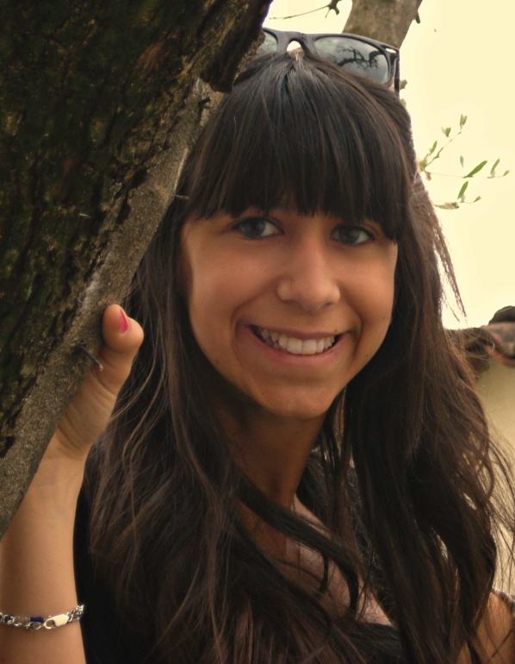
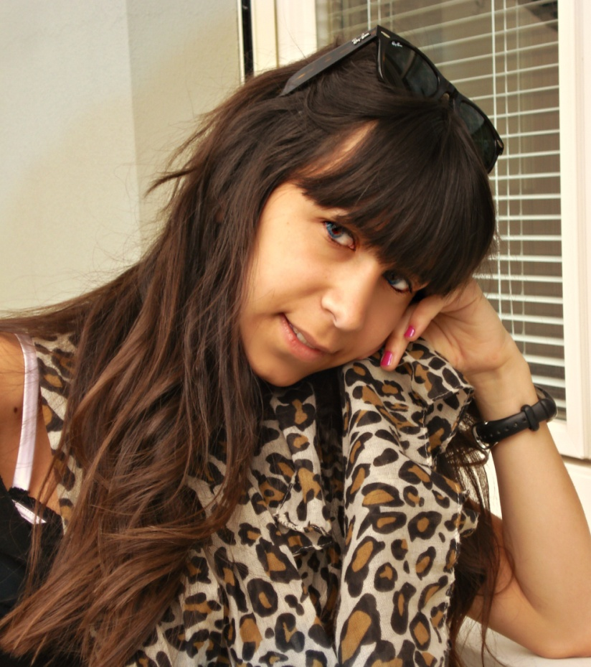
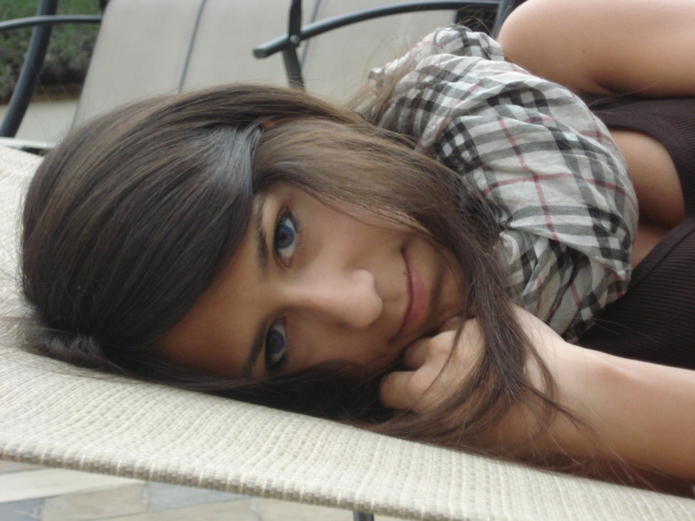
I am Andrea Chiara and I am seventeen, I was born on 24th March 1995 and I live in Verolavecchia, a small village near Brescia. I have long, straight brown hair, I have brown eyes, and I am not very tall.

Slide 3
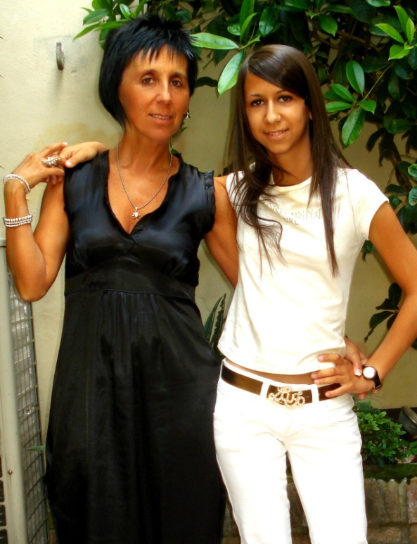
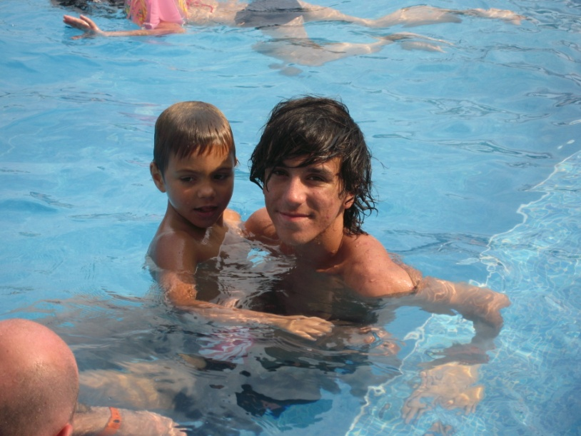
My family
Here’s my mum, her name is Mariarosa and she is a clerk.
The boy on the right is my brother, his name is Nicholas and he is a student, on the left there is my baby friend, he is Bulgarian and his name is Deyvid.

Slide 4
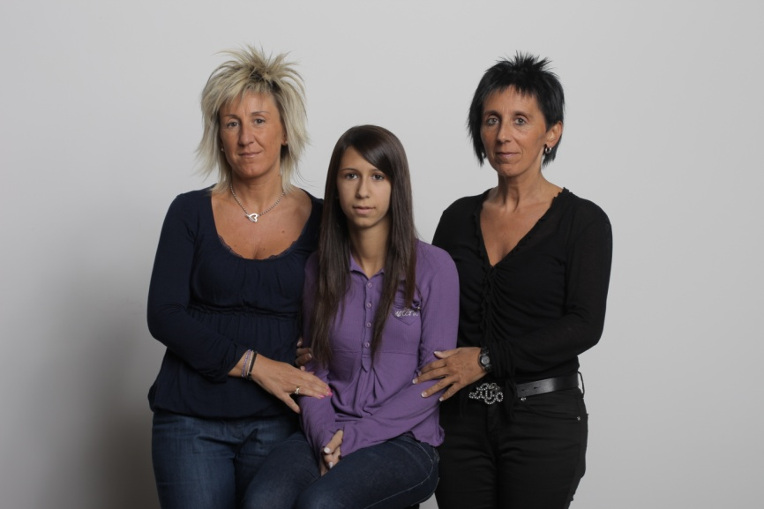
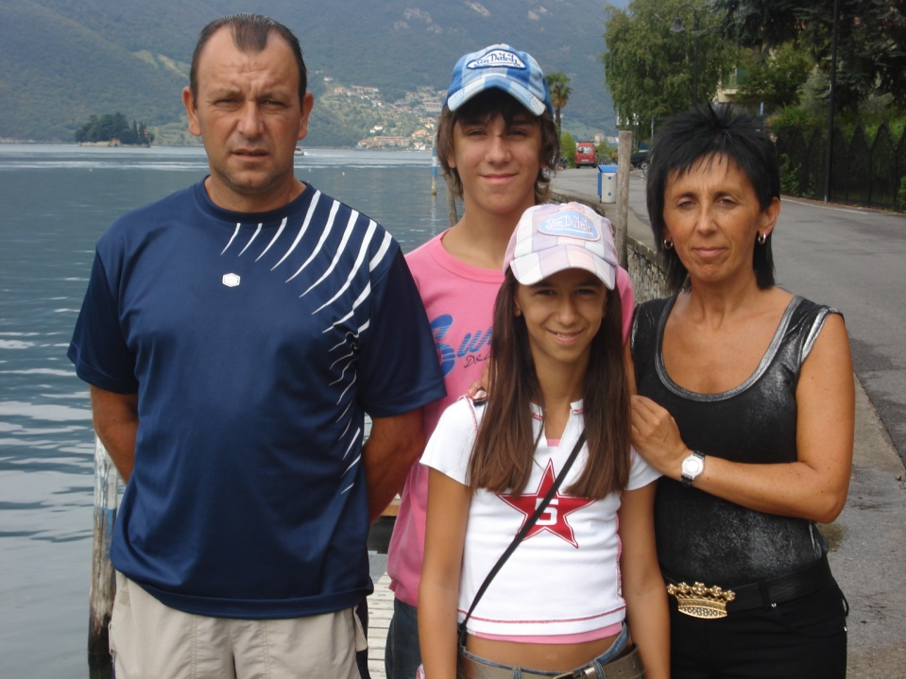
On the left there is my aunt Pierangela, she is my mum’s sister and she has a coffee and I often go to help her.
The man on the left is my father Walter , he is a bricklayer.

Slide 5
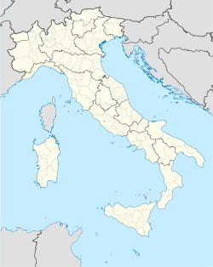
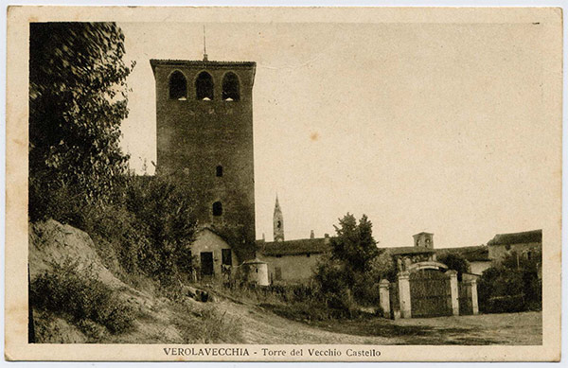
My town
Verolavecchia
Verolavecchia is a little town in the province of Brescia, in Lombardy. It has 4000 inhabitants more or less but even if it isn’t a big place I like it because I know all the people who live there ‘s every you need.

Slide 6
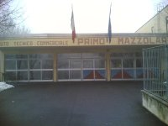
My school
I attend the third class of the High School ITC Primo Mazzolari in Verolanuova. The school isn’t far from Verolavecchia, there are only 2 Km from my house so I can get up at 7.30 every morning.

Slide 7
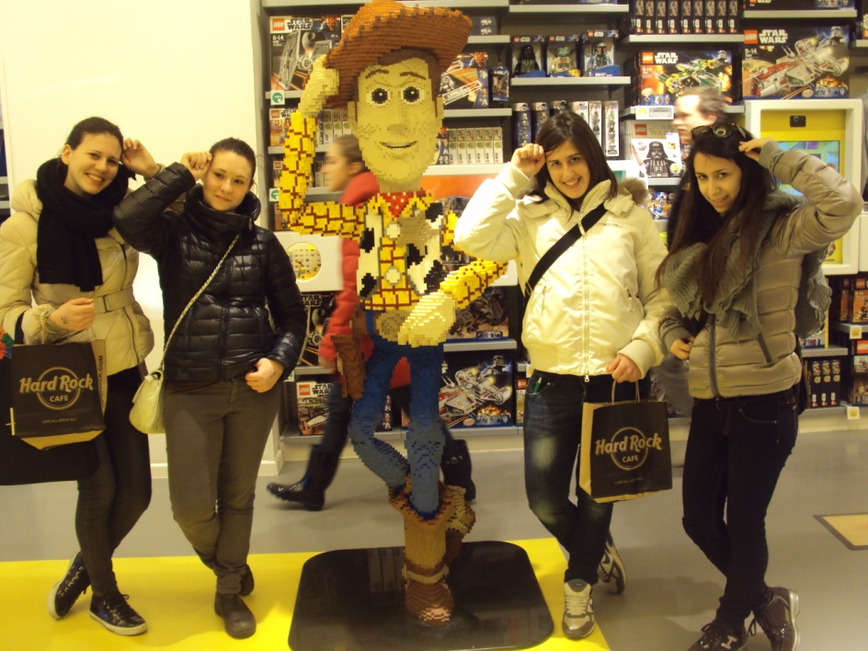
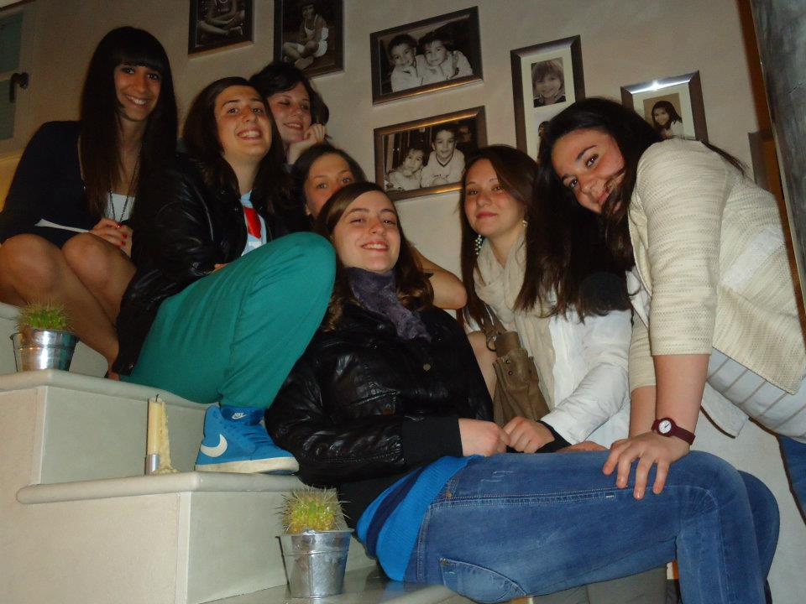
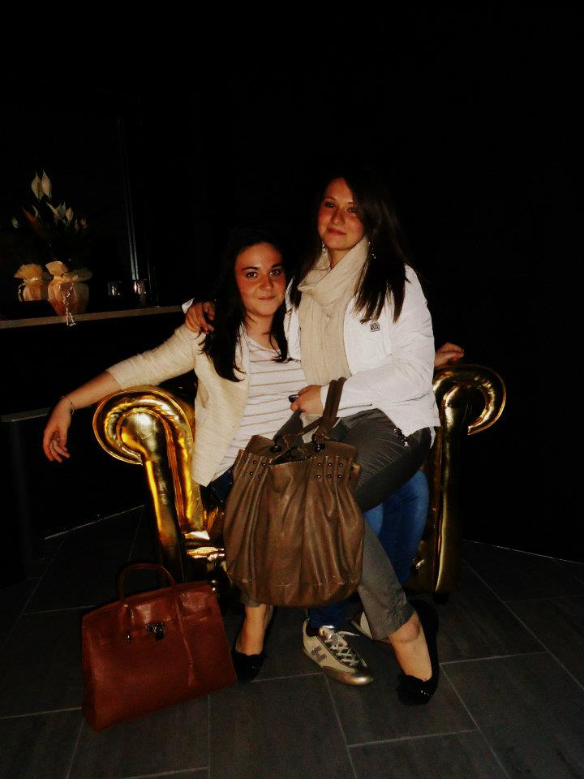
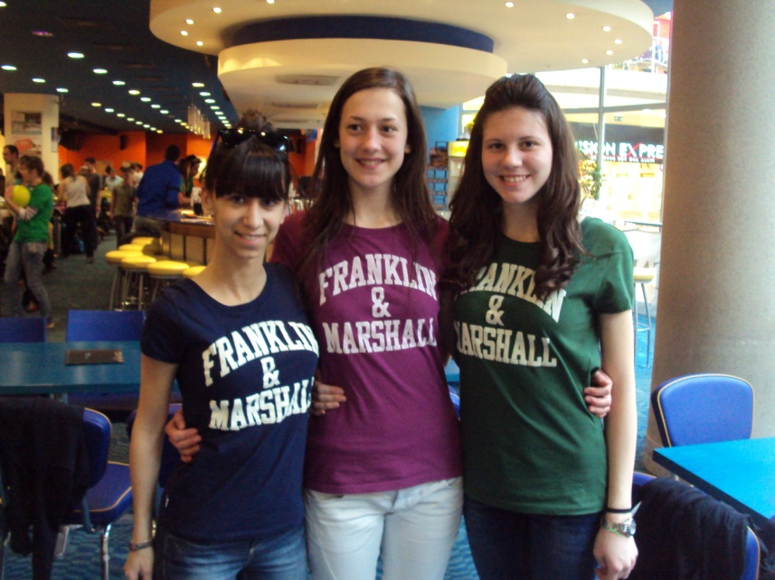
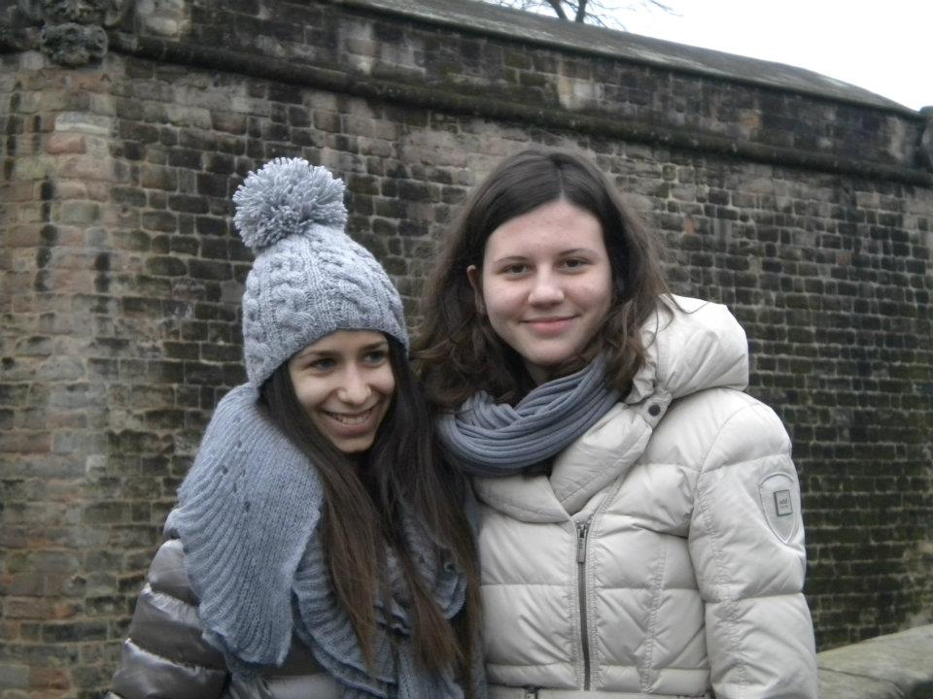
My friends

Slide 8
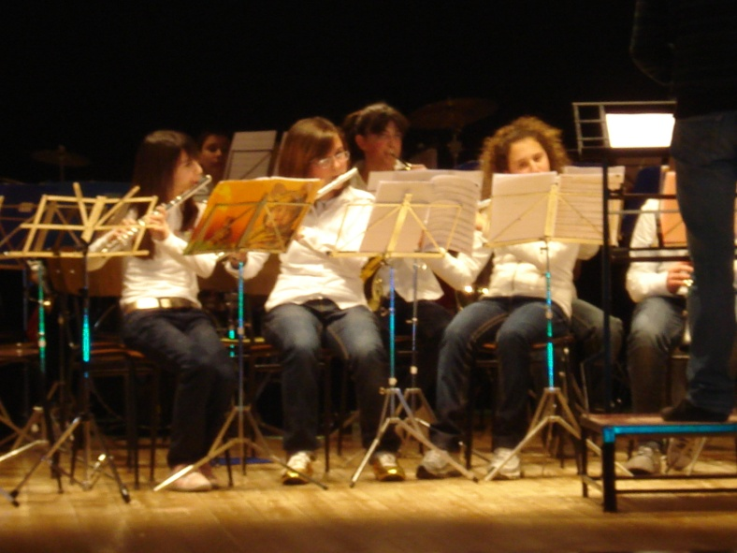
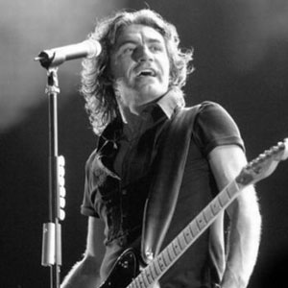
In my free time I like:
_ Playing the flute _ Listening to music _ Reading _ Going to the gym _ Going out with my friends _ Surfing the net

Slide 9
Bye bye.. See you soon! ☺

